Slide 1
FIRST AID IN HEALTH CARE ASSISTANCE(30hrs)
MARCH 2025
LORENCHIO

Slide 2
Your only limit is your mind." —Unknown
Success is the sum of small efforts, repeated day in and day out." —Robert Collier

Slide 3
Module outcomes-
Utilize concepts and principles of first Aid in provision of personalized client care
Utilize techniques of safe use of body mechanics in patient care
Apply skills in basic emergency procedures
MODULE CONTENT
Concepts and principles in first aid
Safe use of body mechanics
Basic emergency procedures

Slide 4
dEFINITION
First Aid is the initial assistance or treatment given to someone who is injured or suddenly taken ill
FIRST AID is the first help given to a casualty, using available materials, with acceptable principles of treatment awaiting medical care
First Aid is the immediate care of an injured or suddenly sick person. It is the care a person applies as soon as possible after an accident or sudden illness

Slide 5

Incident Problems
Casualty problems
Crowd
Hazardous material
Fire
Visibility
Falling objects
Smoke and fumes
Power lines
Bleeding
Unconsciousness
Fainting
Burns
Fractures
Asthma attack
Seizures

Slide 6
Aims of First Aid
Preserve life
This includes the life of the casualty, bystander and rescuer
ABC of resuscitation
Protect the casualty from further harm
Ensure the scene is safe
Provide pain relief/promote recovery
This could include the use of ice packs or simply applying a sling

Slide 7
(a bandage used to suspend or support an injured part of the body)
Prevent the injury or illness from becoming worse
Ensure the treatment you provide does not make the condition worse

Slide 8
Objectives of First Aid
To preserve life
To alleviate suffering
To promote recovery
To prevent aggravation of the injury or illness until veterinary assistance can be obtained

Slide 9
Definition of terms
First Aider
A person who offers emergency care to the casualty(ies)
Victim/casualty
A person suffering from a sudden injury or trauma or illness and needs first aid

Slide 10
Emergency
An unexpected incidence serious in nature that requires quick action,e.g poisoning, burns etc
Scene
An area on incident
Incident
It’s a happening traumatic in nature that requires first aid(it could be illness or injury)

Slide 11
QUALITIES OF A GOOD FIRST AIDER
Should have common senses
Be observant
Be resourceful-make best use of what you have at hand
Be gentle
Be tactful
Confident
Be sympathetic /empathetic
Should not discriminate
percevere

Slide 12
The First Aider Qualities
Highly trained i.e. have necessary knowledge
Examined and regularly re-examined
Have empathy and understanding
Are up-to-date in knowledge and skill
Have initiative and sense of leadership
Have ability to act quickly, make decisions and improvise

Slide 13
RESPONSIBILITIES?
Safety of self, crew, bystanders and casualty
Scene assessment stabilization and safety
Emergency aid to casualty
Telephoning for help and requesting back up
Taking care of casualty belonging
Feeling inn occurrence book during emergency and notifying authority
Taking care of first aid kit
Advising management on safety issue

Slide 14
To prevent cross infection between yourself and the casualty as much as possible
Protecting the casualty
To prevent/avoid cross-infection when giving first aid you should:
Avoid contact with body fluids
Wash your hands
Wear protective gloves
If gloves are unavailable, life saving treatment must still be available

Slide 15
PERSONAL PROTECTIVE EQUIPMENTS
GLOOVES
SAFETY GOOLES
SAFETY BOOTS
REFLECTIVE JACKETS
MASKS
HELMETS

Slide 16
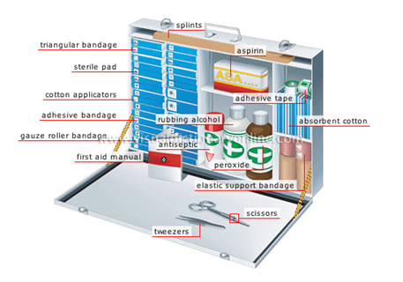
First Aid Kit
Following are the contents of a First Aid Kit :
Cotton wool
Adhesive tape
Crepe bandage
Sterile Dressing
Bandage
Thermometer
Scissors
Glove
Soap
Dettol

Slide 17
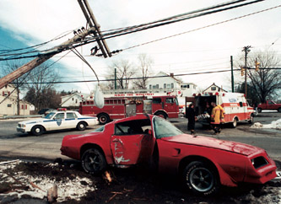
EMERGENCY SCENE MANAGEMENT

Slide 18
ACTION PLAN
ACTION PLAN- USE ACRONYM AMEGA
Assess situation( area)
Make area safe( manage incident)
Emergency aid
Get help
Deal with Aftermath

Slide 19
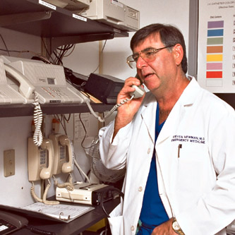
CALLING FOR HELP
Who you are
Where you are
What has happened
What you need
Confirm massage
Time
NB:4WCT

Slide 20
LIFE THREATENING CONDITIONS
AIRWAYIs airway clear of objects?
Is airway open?
ATHING
Is chest rising and falling?
Can you hear victim's breathing?
Can you feel the breath on your cheek?
CIRCULAON
Can you feel a pulse?
Can you see any obvious signs of life?
What’s the skin color and condition
Is there any bleeding

Slide 21
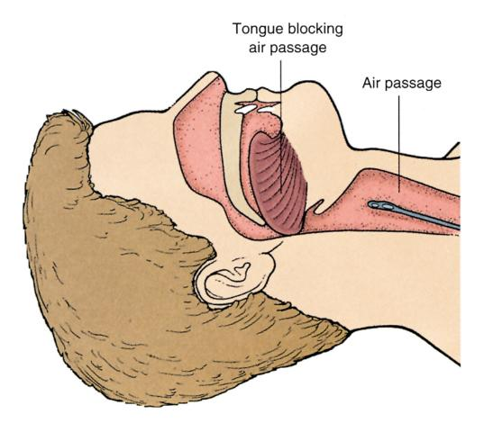
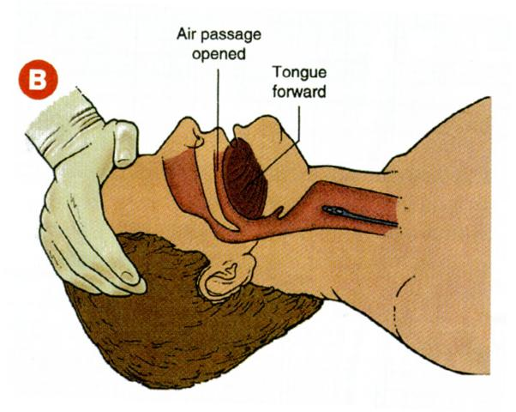
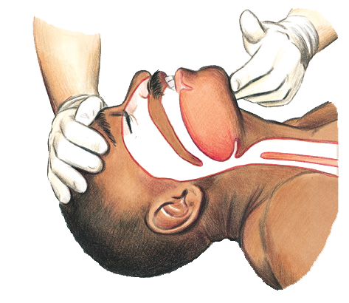
WHAT YOUR TONGUE COULD DO

Slide 22
CASUALTY MANAGEMENT
PRIMARY SURVEY: Initial assessment of casualty to check on priority of life.
Danger
Response (A.V.P.U)
Help
Airway
Breathing
Circulation
DR.H ABC

Slide 23
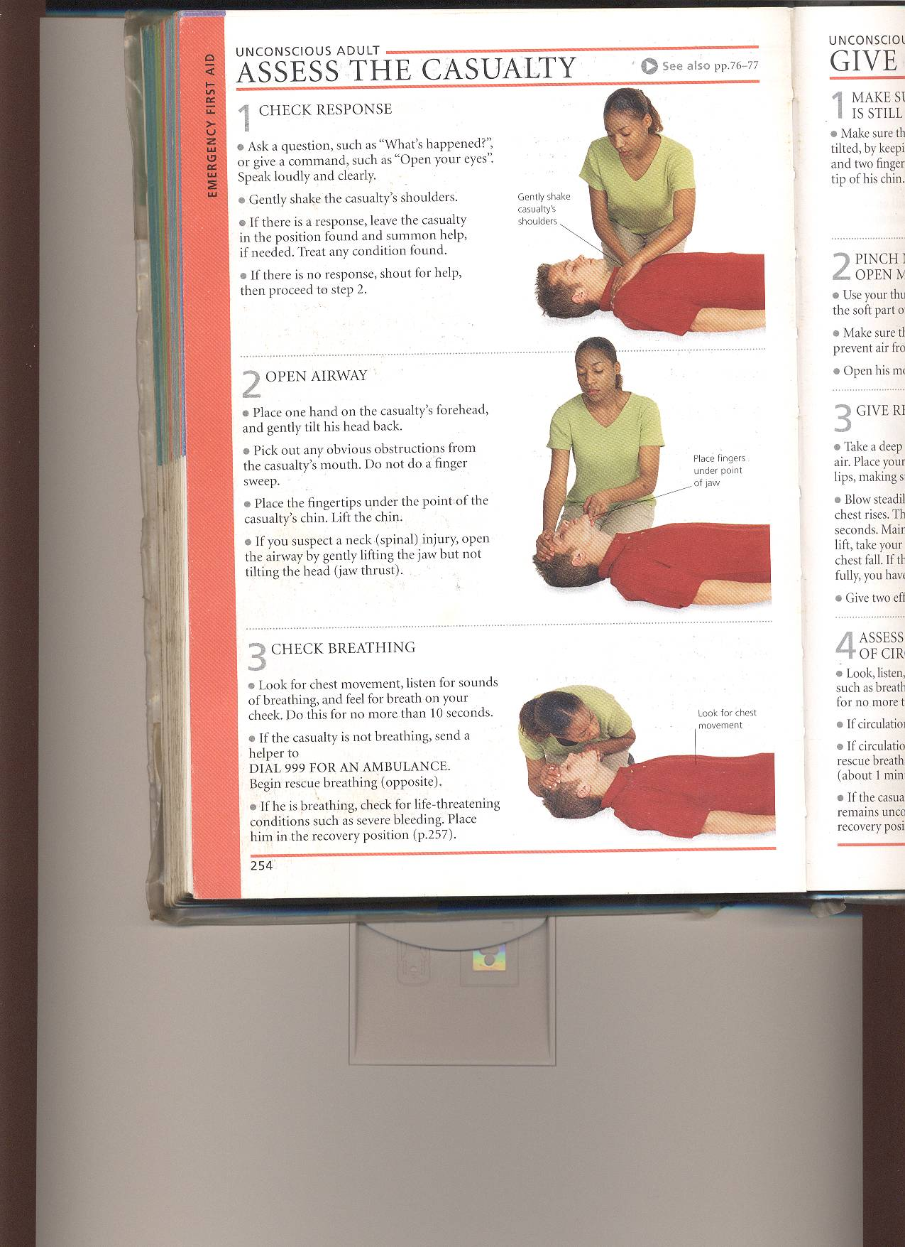
PRIMARY SURVEY PRIORITIES
Danger
Remove any dangers to you, bystanders or casualty
Response
Question, command
& Shake.
Continued

Slide 24
LEVEL OF RESPONSE
Question
Command
Shake or Pinch
Alert
Voice
Pain
Unresponsive

Slide 25
If there is a response:
Summon help if needed.
Assess and Treat any condition or Injury found.
Monitor and record.
If there is no response:
Shout for help (if alone)
open the airway
Continued

Slide 26
Airway
Open the airway by head tilt, chin lift maneuver

Slide 27
Breathing
Look, Listen and Feel for 10secs
Continued

Slide 28
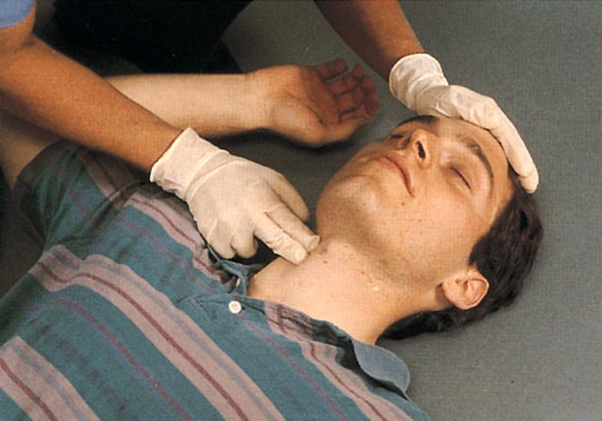
Circulation:
Check for signs of life: normal skin colour,
Temperature, movements or a pulse if
you can(10 seconds)
Check for signs of severe
bleeding and stop it if
you can
Continued

Slide 29
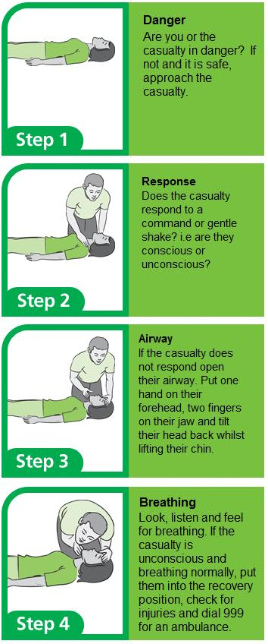

Slide 30
CASUALTY MANAGEMENT
SECONDARY SURVEY: Secondary assessment of casualty to check on other injuries .(Top to toe survey)
Signs & symptoms
Allergies
Medical history
Previous history
Last oral intake
Event that lead to the occurrence

Slide 31
Unconscious casualty management breathing present:
Danger
Response
Help
Airway
Breathing-present
Circulation
Recovery position- Why recovery position?

Slide 32
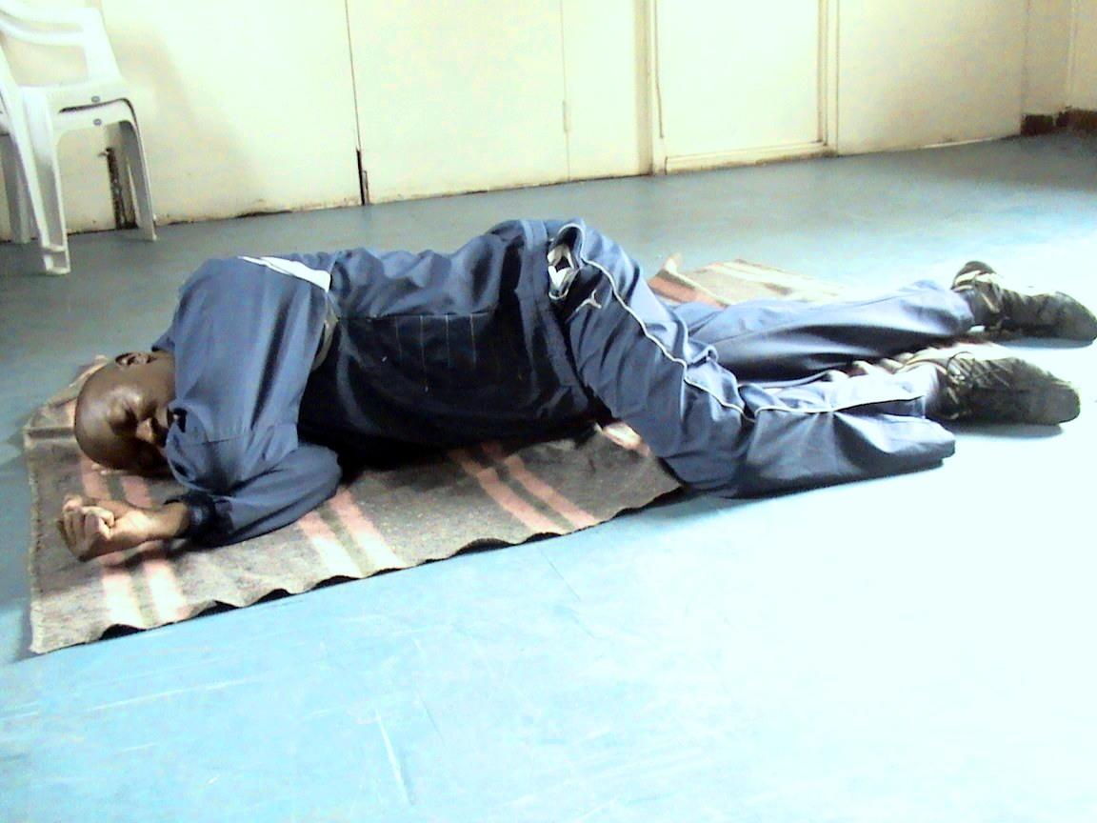
Aim : is to maintain an open airway
Management: Turn to Recovery Position

Slide 33
Unconscious casualty management breathing Absent:
CARDIO PULMONARY RESUSCITATION (C.P.R)
Involves compressing the centre of chest with your hand( 30 C.C)
And giving artificial ventilation with your mouth(2 R.B)

Slide 34
Unconscious casualty management breathing Absent:
Danger
Response
Help
Airway
Breathing-Absent
30 Chest Compression
2Ventilation

Slide 35
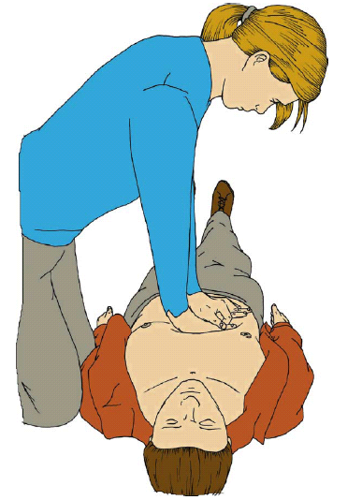


LOCATE THE CENTRE OF THE CHEST
2
30
CONTINUE UNTIL?

Slide 36
C.P.R SUMMARY
Danger
Response
Airway (open)
Breathing (absent)send 4 help now
Chest compressions -30
Artificial ventilations– 2
Keep repeating 30 compressions
and 2 ventilations till……

Slide 37
First Aid Priorities
Assess the situation
Observe what has happened quickly and calmly
Look for danger to yourself and to the casualty
Make the area safe
Protect the casualty from danger
Beware of your limitations

Slide 38
Assess all casualties and give emergency first aid
Assess each casualty to determine treatment priorities and treat those with life threatening conditions first.
Get help
Quickly ensure that any necessary specialist help has been summoned and is on the way

Slide 39
Assignment: General Rules of First Aid Treatment
Triaging
This is sorting and classifying injured patients to determine priority of need
The most critical are taken care of first
Direct assistance to casualties is given by the casualty nurse

Slide 40
The mnemonic START is used.
S-Simple
T-Triaging
A-And
R-Rapid
T-Treatment

Slide 41
First Aid Steps
Before attending to a casualty, you must survey the whole scene
Your first responsibility is to make that the area is safe
Where the danger is too imminent or great, you may need to move the casualty even at risk of aggravating injury
Only when the casualty is safe can you begin to treat illness and injury

Slide 42
Ensure personal safety so that you don’t become a casualty
Send for help
1)ASSESSMENT
When safe to do so, quickly perform a brief examination of the casualty. This is to check for any life threatening conditions that need urgency and to preserve life

Slide 43
You do assessment before making a full diagnosis and if necessary, be prepared to carry out appropriate steps to resuscitate the casualty first
i)Check consciousness
If casualty does not respond when spoken to, he might be unconscious. Try to elicit a response and be careful not to move the head or tilt the neck

Slide 44
ii)Open the airway
An unconscious casualty’s airway may be blocked by the tongue falling back. Open airway by tilting the head back
iii)Check for breathing
Once airway is open, establish whether the casualty is breathing, if not, place in recovery position.
Give artificial breaths

Slide 45
iv)Check for circulation
If the heart is beating, you should be able to feel a pulse in the neck(carotid pulse) or wrist(radial pulse).
For the babies, check brachial pulse
v)Check for bleeding
Severe loss of blood reduces circulation to the vital organs and can cause shock

Slide 46
Control serious bleeding as soon as breathing and pulse have been established
As soon as you establish the condition of the casualty, take action depending on
Unconcious,not breathing and without pulse
Unconcious,not breathing and with a pulse

Slide 47
RESUSCITATION TECHNIQUES
RESUSCITATION SEQUENCE
Check response
Open airway
Check breathing
Assess for circulation
Commence CPR

Slide 48
SAFE USE OF BODY MECHANICS
Safe body mechanics refers to using the body in an efficient and careful way to avoid injury—especially when lifting, pushing, pulling, or performing repetitive tasks. It's essential for protecting your muscles, joints, and spine during work or daily activities.

Slide 49
Key Principles of Safe Body Mechanics:
Maintain a neutral spine
Keep the back straight (natural curve), avoid twisting.
Engage your core muscles.
Lift with your legs, not your back
Bend at the hips and knees—not the waist.
Keep the object close to your body.
Use your leg muscles to rise, not your back.
Keep a wide, stable base of support
Stand with feet shoulder-width apart.
This improves balance and reduces strain.

Slide 50
Avoid twisting while lifting
Pivot with your feet if you need to turn.
Twisting under load increases injury risk.
Hold objects close to your center of gravity
Carry loads close to your chest, not arms extended.
Keeps your center of mass stable.
Push rather than pull
Pushing uses stronger muscles and reduces strain.
Use body weight to assist the motion.
Adjust the height of the work
Avoid working in awkward postures.
Use stools, reach tools, or adjustable equipment if needed.

Slide 51
Use assistive devices
Dollies, slide sheets, lifting belts, or hoists can reduce physical stress.
Plan the movement
Clear the path.
Know where you’re going and how you’ll move the object.
Take breaks and stretch
Fatigue increases risk.
Regular breaks and stretching improve flexibility and circulation.

Slide 52
Transferring a patient to a stretcher
Before the Transfer:
Assess the client's condition:
Level of consciousness, mobility, pain, and ability to assist.
Assemble the team (at least 2 people, ideally 3–4):
More people reduce strain and improve control.
Explain the procedure to the client:
Reduces anxiety and encourages cooperation if able.
Check equipment:
Ensure the stretcher is stable, locked, and level with the bed.
Use a transfer sheet or sliding board.

Slide 53
Steps for Transferring Using a Transfer Sheet or Slide Board:
Steps for Transferring Using a Transfer Sheet or Slide Board:
Position the stretcher:
Lock the wheels.
Align stretcher parallel and close to the bed (or slightly lower than the bed height).
Prepare the client:
Ensure the client is lying flat (if condition allows).
Cross the client's arms over their chest and legs together.
Roll the client slightly to one side to place the transfer sheet or slide board under them, then roll them back onto it.
Caregivers take position:
One or two people on each side of the bed/stretcher.
Feet shoulder-width apart, knees slightly bent, backs straight.
Grasp the sheet or board handles firmly.

Slide 54
Count and coordinate:
Use a “1–2–3” count to move smoothly.
Slide the client gently across to the stretcher.
Reposition the client:
Center them on the stretcher and ensure comfort and alignment.
Raise side rails and ensure safety before moving.

Slide 55
General Guidelines for Transferring a Patient to a Bed
🔹 1. Prepare the Environment
Lock the bed and adjust it to a working height (slightly lower than the transferring surface if moving to the bed).
Lock the wheelchair or stretcher wheels (if applicable).
Remove obstacles and ensure side rails are lowered on the side you're transferring to.
Have transfer aids ready: gait belt, slide board, or transfer sheet.

Slide 56
Transfer Scenarios and Steps
▶️ From Wheelchair to Bed (Partial or Full Assistance):
Explain the procedure to the patient.
Put on a gait belt if the patient can bear weight.
Position the wheelchair at a 45-degree angle to the bed, on the patient’s stronger side if possible.
Lock the wheels and move footrests out of the way.

Slide 57
Assist the patient to stand:
Use proper body mechanics.
Count aloud: “On 3, we’ll stand.”
Pivot toward the bed:
Have the patient feel the bed behind their knees.
Lower the patient onto the bed:
Assist them to sit, then lie down safely.
Support the head, neck, and legs as needed.

Slide 58
From Stretcher to Bed (Using a Slide Sheet or Board)
Place bed and stretcher side by side.
Lower side rails and ensure surfaces are level.
Use a slide board or transfer sheet under the patient.
Team of 2–4 caregivers, one on each side.
Count and slide gently:
“1–2–3—slide.”
Keep back straight and bend from the hips and knees.

Slide 59
Transferring a Patient to an Ambulance: Step-by-Step Guide
Preparation
Assess the patient’s condition: Consciousness, mobility, injuries, and need for immobilization.
Explain the procedure to the patient (if conscious).
Gather necessary equipment:
Stretcher (gurney)
Backboard (if spinal injury suspected)
Scoop stretcher or stair chair (for confined spaces or stairways)
Straps and blankets

Slide 60
Stabilize the Patient
Immobilize the neck and spine if trauma is suspected using a cervical collar and backboard.
Ensure IV lines, catheters, or monitors are secured and portable.
Cover the patient with a blanket for warmth and modesty.

Slide 61
. Position and Secure on the Stretcher
Use a draw sheet or slide board to move the patient from bed/floor to the stretcher.
Maintain proper body mechanics:
Back straight, knees bent.
Lift with legs, not your back.
Keep patient close to your body.
Secure the patient with straps at the chest, hips, and legs.
Raise stretcher side rails before moving.

Slide 62
4. Transport to the Ambulance
Keep the stretcher level and push feet-first when possible.
Use ramps, lift systems, or assistance when navigating curbs or steps.
Ensure good communication between team members.

Slide 63
5. Loading into the Ambulance
Position the stretcher to align with the loading ramp or hydraulic lift.
Lock stretcher wheels before lifting or loading.
Use mechanical lift or manual loading system:
If manual: One rescuer lifts the foot end, another guides the head end.
Slide the stretcher into the ambulance until it locks into place.

Slide 64
Final Safety Check
Ensure stretcher is locked in place.
Re-check patient’s position, vitals, and security of equipment and straps.
Confirm communication with the receiving facility.

Slide 65
Safe Body Mechanics Reminder
Always work in teams of 2 or more for lifting.
Use assistive devices when available.
Avoid sudden movements, twisting, or bending at the waist.

Slide 66
Steps for Transferring a Patient to a Wheelchair
🔹 1. Prepare the Environment
Explain the procedure to the patient.
Lock the wheelchair and place it at a 45-degree angle to the bed or chair.
Move footrests out of the way and ensure armrests won’t obstruct the transfer.
Adjust bed height so the patient’s feet can touch the floor if possible.
Have a gait belt ready for safety.

Slide 67
Position the Patient
Help the patient move to the edge of the bed or chair.
Ensure their feet are flat on the floor and close together.
Place a gait belt securely around the patient’s waist if assistance is needed.
Have the patient place their hands on the bed or armrest to assist if able.

Slide 68
3. Assist with Standing
Stand close, with your feet shoulder-width apart.
Bend at the knees, not the back.
Grip the gait belt with both hands.
Instruct the patient: “On 3, we’ll stand.”
Rock gently to build momentum, then assist them to stand up on the count of 3.

Slide 69
4. Pivot to Wheelchair
Pivot with your feet, not your back, turning the patient toward the wheelchair.
Make sure the back of the patient’s legs touches the wheelchair seat.

Slide 70
5. Assist into the Wheelchair
Gently lower the patient into the seat, bending your knees and keeping your back straight.
Ensure the patient is centered and sitting back fully in the chair.

Slide 71
. Finalize Position
Place footrests back under the patient’s feet.
Ensure patient’s hands and feet are safe and not pinched.
Offer a blanket or support if needed.

Slide 72
Safety & Body Mechanics Tips
Keep patient close to your body.
Do not twist your spine—pivot with your feet.
Use gait belts for better control and support.
Always lock the wheelchair before the transfer.

Slide 73
Basic Emergency procedures
Basic emergency procedures are essential for providing immediate care and minimizing harm until professional help arrives. Knowing how to respond in various situations can save lives

Slide 74
1. Assess the Situation
Ensure your safety first: Make sure the environment is safe for both you and the patient.
Check responsiveness: Tap or shake the patient gently. If no response, call for help immediately.
Assess the patient's condition (breathing, heart rate, bleeding, etc.).

Slide 75
2. Call for Help
Call emergency services (911 or local emergency number) immediately.
Provide clear information:
Location of the emergency
Number of people involved
Type of emergency (e.g., heart attack, severe bleeding, unresponsive)
Condition of the person (conscious, breathing, etc.)

Slide 76
3. Perform CPR (Cardiopulmonary Resuscitation) – If Necessary
If the patient is unresponsive and not breathing:
Check for a pulse: If no pulse, begin CPR.
Compressions:
Place hands in the center of the chest (on the sternum).
Use your body weight to compress the chest 2 inches deep at a rate of 100–120 compressions per minute.
Rescue Breathing (If trained):
After 30 compressions, give 2 rescue breaths (tilt the head back, pinch the nose, and breathe into the mouth until the chest rises).
Repeat cycles of 30 compressions and 2 breaths.

Slide 77
4. Control Severe Bleeding
4. Control Severe Bleeding:
Apply direct pressure: Use a clean cloth or bandage and press down firmly on the wound.
Elevate the limb (if no fractures are suspected).
Use a tourniquet (if bleeding cannot be controlled with direct pressure and it's life-threatening).
Keep the person calm to reduce blood pressure and prevent further bleeding.
If the bleeding is from an arm or leg, elevate it above the heart if possible.

Slide 78
5. Treat for Shock:
Signs of shock: Pale skin, rapid breathing, confusion, weak pulse, or dizziness.
Position the patient: Lay them flat on their back and elevate their feet about 12 inches (unless this causes pain or injuries).
Keep the patient warm: Use a blanket to cover them, but don’t overheat.
Avoid giving food or water (could cause choking or vomiting).

Slide 79
6. Perform the Heimlich Maneuver (Choking):
If the patient is choking and unable to breathe or speak:
Assess: If the person can’t speak, cough, or breathe, they are choking.
Give 5 back blows: Stand behind the person and lean them forward. Deliver 5 sharp blows between the shoulder blades.
Perform abdominal thrusts:
Stand behind the person and place your hands above the navel.
Thrust inward and upward with quick, forceful motions.
Repeat: Continue until the object is dislodged or the person begins to breathe again.

Slide 80
6. Perform the Heimlich Maneuver (Choking):
:
For a minor burn:
Run cool (not cold) water over the burn for 10-20 minutes.
Cover with a clean, non-stick bandage.
Do not pop blisters.
For major burns:
Call emergency services immediately.
Cover the burn area with a clean cloth (preferably sterile) to prevent infection.
Avoid using ice or creams on severe burns.

Slide 81
8. Treat Fractures and Sprains:
For suspected fractures:
Immobilize the injured area with a splint (or makeshift material like a board).
Apply ice to reduce swelling, but not directly on the skin.
Avoid moving the patient if you suspect a spinal or neck injury.
For sprains or strains:
Use the R.I.C.E. method:
Rest the injured part.
Apply Ice for 20 minutes every 2 hours.
Compress with an elastic bandage to reduce swelling.
Elevate the limb above heart level.

Slide 82
9. Handle Seizures
Stay calm and protect the person from injury (move sharp objects away).
Place something soft under the head (like a folded cloth or pillow).
Do not put anything in the mouth.
Time the seizure: If it lasts more than 5 minutes, call emergency services.
After the seizure, turn the person onto their side to keep the airway clear.

Slide 83
10. Dealing with Heat and Cold Emergencies:
Heat Exhaustion or Heat Stroke:
Signs: Heavy sweating, weakness, nausea, dizziness, confusion.
Cool the person down: Move them to a cooler place, remove excess clothing, and apply cool (not cold) water.
Rehydrate: Give small sips of water or electrolyte drink, but avoid caffeine or alcohol.
Hypothermia (Cold Exposure):
Signs: Shivering, slurred speech, confusion, numbness.
Warm the person gradually: Use blankets, warm (not hot) fluids, and dry clothes.
Do not rub the skin or warm rapidly as this can cause shock.

Slide 84
Signs of Choking
The person is unable to speak or breathe.
Coughing or wheezing may be present but ineffective.
They may grab their throat (universal sign for choking).
The person may be turning blue or losing consciousness if the airway is completely blocked.

Slide 85
Signs of Choking
Assess the Situation
Ask: "Are you choking?" or “Can you cough?”
If the person can speak or cough, encourage them to keep coughing to clear the obstruction on their own.
If they cannot speak or cough, they need immediate help.
ou choking?" or “Can you cough?”
If the person can speak or cough, encourage them to keep coughing to clear the obstruction on their own.
If they cannot speak or cough, they need immediate help.

Slide 86
Assess the Situation
Ask: "Are you choking?" or “Can you cough?”
If the person can speak or cough, encourage them to keep coughing to clear the obstruction on their own.
If they cannot speak or cough, they need immediate help.

Slide 87
Perform the Heimlich Maneuver (Abdominal Thrusts)
For Adults and Children Over 1 Year:
Stand behind the patient:
Place your arms around their waist.
Lean them forward slightly to prevent the object from going further into the airway.
Make a fist with one hand:
Position the thumb side of your fist just above the person’s navel (belly button).

Slide 88
Grasp your fist with the other hand:
Press into the abdomen with quick, upward thrusts (as if you are trying to lift the person off their feet).
Repeat: Perform 5 quick abdominal thrusts.
Check for the object:
After each thrust, check if the object has been expelled.
If the person starts coughing or breathing, encourage them to continue coughing.

Slide 89
For Pregnant Women or Obese Adults:
Place your hands higher (around the chest, not the abdomen) and perform chest thrusts instead of abdominal thrusts.

Slide 90
If the Person Becomes Unconscious
If the choking person becomes unresponsive:
Call 911 or emergency services immediately (if you haven't already).
Start CPR:
Check the airway: Open the mouth and look for any visible object. If you can see it, remove it with a finger sweep, but only if you can do so easily (don’t perform a blind finger sweep, as it may push the object further down).
Give chest compressions: Start with 30 compressions (2 inches deep and at a rate of 100–120 per minute).
Give rescue breaths: After 30 compressions, give 2 rescue breaths, watching for the chest to rise.

Slide 91
For Infants (Under 1 Year)
Position the infant:
Hold the infant facing down on your forearm (support the head and neck).
Keep the head lower than the chest.
Give 5 back blows:
Using the heel of your hand, deliver 5 firm back blows between the infant’s shoulder blades.

Slide 92
Flip the infant over:
If the object is still not dislodged, turn the infant onto their back (while still supporting the head and neck).
Give 5 chest compressions:
Place two fingers in the center of the infant’s chest just below the nipple line.
Perform 5 quick chest compressions (about 1.5 inches deep).
Repeat: Continue alternating 5 back blows and 5 chest compressions until the object is expelled or the infant becomes responsive.

Slide 93
Controlling bleeding
Controlling bleeding is critical in any emergency situation, as uncontrolled bleeding can lead to shock and be life-threatening. Here’s a step-by-step guide on how to assist in controlling bleeding.

Slide 94
1. Assess the Situation
1. Assess the Situation
Ensure your safety first: Check for potential dangers (e.g., traffic, fire, electrical hazards).
Evaluate the type and severity of bleeding: Is it arterial, venous, or capillary? Arterial bleeding is bright red and spurts, while venous bleeding is darker and flows steadily.

Slide 95
Protect Yourself
Use personal protective equipment (PPE): Wear gloves, and if available, use a face shield or mask to prevent contact with bodily fluids.
Apply Direct Pressure
Use a clean cloth, dressing, or bandage to apply pressure directly to the wound.
If you don’t have a sterile dressing, any clean material (t-shirt, towel, etc.) can be used.
Press firmly: Apply enough pressure to stop the blood flow.
For heavy bleeding, you may need to apply more pressure to control the flow.

Slide 96
Apply Direct Pressure
Use a clean cloth, dressing, or bandage to apply pressure directly to the wound.
If you don’t have a sterile dressing, any clean material (t-shirt, towel, etc.) can be used.
Press firmly: Apply enough pressure to stop the blood flow.
For heavy bleeding, you may need to apply more pressure to control the flow.

Slide 97
4. Elevate the Injured Limb (If Possible)
If the injury is to an arm or leg, elevate the limb above the level of the heart to help reduce blood flow to the area.
Caution: If you suspect a bone fracture or spinal injury, avoid moving the limb unless absolutely necessary.

Slide 98
5. Apply Additional Bandages if Needed
If the cloth or bandage becomes soaked with blood, do not remove it.
Add more dressings on top and continue to apply pressure.
Keep pressure on the wound until the bleeding slows down or stops.

Slide 99
6. Apply a Tourniquet (If Direct Pressure Fails and Bleeding is Severe)
Use a tourniquet if the bleeding cannot be controlled with direct pressure, especially in cases of arterial bleeding or severe limb injury:
Place the tourniquet: Position it above the wound (closer to the torso) between the wound and the heart.
Tighten the tourniquet: Twist the tourniquet to apply pressure until the bleeding stops. The bleeding should stop within a minute or two.
Note the time: Record the time the tourniquet was applied, as it should not be left on for extended periods without medical help.
Do not remove the tourniquet unless directed by medical professionals.

Slide 100
7. Treat for Shock
Signs of shock include pale skin, rapid breathing, weakness, confusion, or fainting.
Position the patient: Lay them flat and elevate their feet about 12 inches (unless it causes pain or injury).
Keep the patient warm with a blanket to prevent hypothermia.
Monitor vital signs: Keep track of their breathing and pulse. If the patient becomes unconscious and stops breathing, start CPR.

Slide 101
8. Seek Medical Help
Call emergency services (911) immediately if the bleeding is severe, or if the patient is in shock, unconscious, or has multiple injuries.
Even if the bleeding is controlled, the patient needs professional medical care.

Slide 102
9. Do Not
Do not remove objects embedded in the wound. If an object is sticking out, do not attempt to remove it, as it may cause more damage and bleeding.
Do not apply ice directly to the wound as it may cause tissue damage, unless instructed by a medical professional.
Do not delay seeking medical help: Serious bleeding needs professional evaluation and care.

Slide 103
9. Do Not
Arterial Bleeding (Bright Red, Spurting Blood)
This type of bleeding is severe and requires immediate attention. Apply direct pressure as described above, and if necessary, apply a tourniquet above the wound to control bleeding.
Venous Bleeding (Steady Flow of Dark Red Blood)
Apply direct pressure and elevate the limb. If the blood continues to flow, add more bandages on top.
Capillary Bleeding (Oozing, Small Wounds)
This type of bleeding is usually less severe. Apply direct pressure until the bleeding stops. You can often manage this with basic first aid.

Slide 104
Providing assistance to a burn victim
Providing assistance to a burn victim requires quick, calm action to reduce pain, prevent further damage, and stabilize the patient until professional medical help arrives. Here’s a step-by-step guide for assisting a burn victim:

Slide 105
1. Ensure Safety First
1. Ensure Safety First
Remove the victim from the source of the burn (e.g., fire, hot liquid, electrical source).
If the burn is caused by chemical exposure, ensure the victim is moved away from the chemical source and that the chemical is removed from the skin (e.g., rinse with water for chemical burns).
Check for any other hazards (e.g., fire, smoke, electrical wiring) to ensure both you and the victim are safe.

Slide 106
2. Assess the Severity of the Burn
Minor Burns (1st Degree): Affect only the outer layer of skin (redness, pain, mild swelling).
Moderate Burns (2nd Degree): Affect both the outer layer and deeper skin layers (blisters, intense redness, swelling).
Severe Burns (3rd Degree): Affect all skin layers, causing damage to deeper tissues (charred skin, white or leathery appearance, numbness at the burn site).

Slide 107
3. Call for Help
3. Call for Help
Call emergency services (911) immediately if the burn is severe (3rd degree), involves the face, hands, feet, or genitals, or if the victim is having difficulty breathing.
For chemical burns or electrical burns, alert emergency services about the type of burn for quicker treatment.

Slide 108
4. Cool the Burn
For minor burns (1st or 2nd degree), cool the burn with running cool (not cold) water for 10-20 minutes or until pain subsides. If running water isn’t available, use any clean, cool water or cool compress.
Do not use ice or very cold water as it may cause further damage to the tissue.
For larger burns, if water isn’t available, use wet cloths or towels to gently cool the area.
For severe burns (3rd degree), do not apply water. Instead, cover the burn with a clean, non-stick cloth or sterile dressing (e.g., clean sheet, towel, or burn dressing).
If available, use a burn dressing or sterile bandage.

Slide 109
5. Protect the Burned Area
Do not break blisters for 2nd-degree burns, as they help protect the underlying tissue.
Cover the burn with a clean, non-stick bandage to reduce pain and prevent infection.
Avoid applying ointments, butter, or creams, as they can trap heat and cause infection.
Keep the victim warm: After cooling, ensure the person is kept warm to prevent shock, but avoid overheating.

Slide 110
6. Position the Victim
For 1st or 2nd-degree burns on limbs, elevate the affected arm or leg to reduce swelling.
For severe burns, position the victim in a comfortable and safe position that minimizes strain on the body. Lay the victim flat if they are feeling faint or dizzy.
If the victim is in shock (cold, clammy skin, rapid breathing, confusion), lay them flat, elevate their feet, and keep them warm.

Slide 111
7. Monitor the Victim
Monitor for signs of shock, such as:
Pale or cold skin
Weak or rapid pulse
Shallow breathing
Confusion or fainting
If the victim becomes unconscious and is not breathing, begin CPR if trained, and continue until emergency responders arrive.

Slide 112
8. Provide Pain Relief (If Possible)
For minor burns, the victim may benefit from over-the-counter pain relievers such as ibuprofen or acetaminophen (if they are conscious and able to swallow).
Avoid giving them fluids that are too hot or too cold, as this can worsen the shock.

Slide 113
9. Do Not
Do not remove burned clothing unless it is on fire. Cut around clothing if necessary, but do not pull it off if it’s stuck to the burn.
Do not apply ice or very cold water to severe burns (3rd-degree burns).
Do not pop blisters.
Do not apply greasy substances like butter, oil, or ointments.
Do not attempt to remove burned jewelry unless it is very easy to do so (burned jewelry can constrict and cause further damage).

Slide 114
10. Get Professional Help
Even if the burn appears to be minor, it’s important to get medical attention to ensure proper care and to check for infection risk.
Severe burns or burns affecting large areas of the body, the face, airway, or sensitive areas need immediate professional care.

Slide 115
Special Considerations
Chemical Burns: Flush the skin with large amounts of water for at least 20 minutes. Be sure to remove contaminated clothing and avoid inhaling toxic fumes.
Electrical Burns: Ensure the victim is no longer in contact with the electrical source (turn off power if safe to do so). Do not touch the victim directly if they are still in contact with electricity. Electrical burns may cause internal injuries, so the victim should seek immediate medical attention.

Slide 116
Summary Checklist:
Ensure safety: Remove the person from the source of the burn.
Assess burn severity: 1st, 2nd, or 3rd degree.
Call 911 for severe burns or if the burn affects sensitive areas (face, hands, feet).
Cool minor burns with running water (10–20 minutes).
Cover severe burns with a clean cloth or sterile dressing.
Protect the burn from infection (do not break blisters).
Monitor for shock and treat accordingly.
Seek medical help for all but the most minor burns.

Slide 117
Assisting a client who has suffered a stroke
When assisting a client who has suffered a stroke, it is critical to act quickly and efficiently. A stroke is a medical emergency where blood flow to the brain is interrupted, causing brain cells to become damaged or die. Immediate action can minimize damage and improve the chances of recovery.

Slide 118
1. Recognize the Signs of a Stroke
The FAST method is a quick and easy way to identify a stroke:
F – Face drooping: Ask the person to smile. Does one side of the face droop or feel numb?
A – Arm weakness: Ask the person to raise both arms. Does one arm drift downward or feel weak?
S – Speech difficulty: Ask the person to repeat a simple sentence. Is their speech slurred or strange?
T – Time to call emergency services: If any of these signs are present, call 911 immediately. Time is critical.

Slide 119
2. Call Emergency Services Immediately
Call 911 (or your local emergency number) right away if you suspect a stroke.
Provide clear information:
The person’s symptoms (e.g., drooping face, weakness, slurred speech)
The time when the symptoms started (if known).
Any medical history (e.g., if the person has had strokes before, or any heart conditions).
Time-sensitive treatment is crucial. The faster medical help arrives, the better the outcome.

Slide 120
3. Stay Calm and Keep the Client Calm
Reassure the person: Let them know that help is on the way and that they are not alone.
Encourage them to stay calm and try to keep them in a comfortable position.
Keep the person lying down with their head slightly elevated (about 30 degrees) unless this is uncomfortable or contraindicated (e.g., difficulty breathing).
If the person is conscious and able to cooperate, help them stay in a relaxed position.
Avoid giving food or drinks, as swallowing may be difficult.

Slide 121
4. Monitor and Record Symptoms
Track the onset of symptoms: Note the exact time when the symptoms started, as time of onset is crucial in stroke treatment. This will help medical professionals determine what kind of treatment is needed.
Monitor the patient’s vitals: If possible, check their pulse and breathing.
If they become unresponsive and stop breathing, begin CPR if trained.

Slide 122
5. Keep the Person Comfortable
Make sure the person is in a safe environment. Clear away any potential hazards they might fall into if they lose consciousness.
Monitor for any signs of worsening symptoms, such as:
Sudden confusion or disorientation
Difficulty breathing
Loss of consciousness

Slide 123
6. Position the Client Correctly
If the person is conscious and alert, keep their head elevated and ensure they are comfortable.
If the person is unconscious:
Place them on their side to keep the airway clear and reduce the risk of choking.
Turn their head to one side to prevent aspiration if they vomit.
If the person is having difficulty breathing, keep them semi-sitting (propped up with pillows) or in a position that facilitates easy breathing.

Slide 124
7. Prepare for Arrival of Medical Personnel
Once emergency services arrive, provide all relevant information:
The time the symptoms started.
Any relevant medical history (e.g., previous strokes, blood pressure issues, medications).
The symptoms the client is exhibiting.

Slide 125
8. Aftercare and Ongoing Monitoring
Follow medical advice once the client is stabilized. Depending on the type of stroke (ischemic or hemorrhagic), the course of treatment may vary.
Support recovery: After medical stabilization, the person may need rehabilitation (physical therapy, speech therapy, etc.). Offer assistance with transportation or coordination for follow-up care if necessary.
Watch for complications: Post-stroke complications include difficulty swallowing, paralysis, speech impairments, and emotional changes.

Slide 126
Important Notes:
Time is critical in stroke treatment. Immediate medical attention can minimize brain damage.
Don't give the person anything to eat or drink. If the stroke affects swallowing, this could lead to choking or aspiration.
If the stroke is suspected to be caused by a blood clot (ischemic stroke), certain medications (thrombolytics) may need to be administered within a specific time frame. Getting medical attention quickly is crucial.

Slide 127
Assisting an unconscious patient
When assisting an unconscious patient, it's critical to act quickly and efficiently. An unconscious person may be unresponsive due to various reasons, including medical conditions (such as a stroke, heart attack, or seizure), trauma, or intoxication.

Slide 128
1. Ensure Safety
Check for any dangers to yourself or the patient (e.g., fire, electrical hazards, or traffic).
Make sure the area is safe and secure for both you and the patient.

Slide 129
2. Check Responsiveness
Gently tap or shake the patient and shout their name, if known.
If they are unresponsive, do not attempt to move them unless necessary to ensure safety (e.g., in case of a fire or dangerous environment).
Assess their breathing and pulse:
Look, listen, and feel for breathing (watch for chest movement, listen for breath sounds, and feel for breath on your cheek).
If they are not breathing or breathing abnormally, call 911 immediately and begin CPR if trained.

Slide 130
3. Call Emergency Services
Call 911 (or local emergency number) if the person is unconscious and you cannot determine the cause.
Provide clear information:
The patient's age and condition
Whether they are breathing
Any known medical history (e.g., diabetes, seizures, or heart problems)

Slide 131
4. Open the Airway
Position the person on their back on a flat surface (if they are not already).
Open the airway by tilting their head backward:
Lift the chin gently with one hand and tilt the head back.
If there is no suspected neck injury, this helps open the airway and allows air to flow freely.
Check the mouth for any obstructions (such as food, vomit, or foreign objects). If something is blocking the airway, clear it out if you can do so safely.

Slide 132
5. Check for Breathing
Look, listen, and feel for normal breathing:
Look for chest movement.
Listen for breath sounds near the person’s mouth.
Feel for breath on your cheek.
If the person is not breathing normally or is breathing erratically (gasping), proceed with CPR (cardiopulmonary resuscitation).

Slide 133
6. Start CPR (If Necessary)
If the person is not breathing or unresponsive, start CPR immediately:
Chest Compressions:
Place the heel of your hand on the center of the chest (just below the breastbone).
Place your other hand on top of the first hand and interlock fingers.
Push hard and fast, aiming for a depth of about 2 inches and a rate of 100-120 compressions per minute.
Rescue Breaths (if trained):
After 30 compressions, give 2 rescue breaths.
Pinch the nose closed, tilt the head back, and give a breath until the chest rises.
Continue the cycle of 30 compressions and 2 breaths until medical help arrives or the person starts to show signs of life (e.g., breathing or movement).

Slide 134
7. If the Person Starts Breathing (Recovery Position)
Once the person starts breathing, place them in the recovery position to keep the airway open and prevent choking.
Positioning:
Kneel beside the person.
Place the arm closest to you at a right angle to the body, with the elbow bent.
Place the other hand on the far side of the person's head, supporting their neck and keeping the head tilted back.
Bend the far knee and pull it up towards the chest, then roll the person towards you on their side.
Adjust the head and neck to ensure the airway remains open. Tilt the head back slightly if necessary to keep the tongue from blocking the airway.
Monitor breathing and pulse: Keep checking their breathing and pulse regularly.
Stay with the person until emergency responders arrive.

Slide 135
8. Monitor the Person's Condition
If the person regains consciousness, keep them calm and still.
Reassure them: Let them know they are safe and help is on the way.
Do not give them food or drink until they are fully alert and able to swallow.
Monitor for signs of deterioration, such as:
Changes in breathing (shallow or irregular breathing)
Changes in consciousness (the person may lose consciousness again)
Seizures or convulsions (if they start convulsing, keep the person safe and do not try to restrain them).

Slide 136
9. Consider Medical History
If you know the person has a chronic condition (e.g., diabetes, epilepsy, or heart disease), inform emergency services when they arrive. This could help medical personnel provide more effective treatment.

Slide 137
10. Stay Calm
Remain calm and focused while you assist the unconscious patient.
Clear communication with emergency responders is essential to ensure timely and effective care.
Keep the patient as comfortable as possible and avoid causing unnecessary movement.

Slide 138
Summary Checklist for Assisting an Unconscious Patient:
Ensure safety: Check for hazards in the environment.
Assess responsiveness: Gently tap the patient and check for breathing.
Call emergency services: Provide clear information about the patient’s condition.
Open the airway: Tilt the head back and check for obstructions.
Check for breathing: Look, listen, and feel for normal breathing.
Start CPR if necessary: Provide chest compressions and rescue breaths.
Recovery position: If breathing resumes, place the patient on their side.
Monitor: Check for any changes in condition while waiting for help.
Stay calm and reassure the patient: Keep them comfortable and alert until help arrives.

Slide 139
Assisting a convulsive client
What Is a Convulsion?
A convulsion (or generalized tonic-clonic seizure) is a type of seizure involving uncontrolled muscle contractions, loss of consciousness, and sometimes incontinence. It may last from a few seconds to several minutes.

Slide 140
Assisting a convulsive client—someone experiencing a seizure—requires calm, protective action to ensure their safety and dignity. Convulsions can be frightening to witness, but with the right steps, you can help prevent injury and support recovery.

Slide 141
1. Stay Calm and Time the Seizure
Look at a clock or start a timer.
Most seizures last 1–3 minutes. If it lasts more than 5 minutes, call emergency services (911) immediately—this is a medical emergency called status epilepticus.

Slide 142
2. Protect the Person From Injury
Ease them to the ground if they’re standing or sitting.
Clear the area of any sharp, hard, or dangerous objects (furniture, glass, tools, etc.).
Place something soft (e.g., a folded jacket or pillow) under their head to prevent head injury.
Loosen tight clothing, especially around the neck (like ties, collars, or scarves).
Do not restrain their movements.
Do not put anything in their mouth—this can cause choking or broken teeth (contrary to popular myth, a person cannot swallow their tongue during a seizure).

Slide 143
3. Stay With Them During the Seizure
Turn them onto their side once the convulsions stop. This helps keep their airway clear in case of vomiting or saliva buildup.
Keep their airway open: Tilt the head slightly back if necessary.
Observe and document:
Duration of the seizure
What body parts were involved
Any injuries that occurred
Their behavior before, during, and after the seizure

Slide 144
4. After the Seizure
The person may be confused, disoriented, or drowsy (this is called the postictal phase).
Reassure them gently: Let them know they are safe and explain what happened.
Stay with them until they are fully awake and alert.
Do not give food, drink, or medication until they are fully conscious and able to swallow safely.
Offer privacy and respect their dignity, especially if incontinence occurred.

Slide 145
5. When to Call for Emergency Help (911):
The seizure lasts more than 5 minutes
The person has trouble breathing or does not regain consciousness
Another seizure begins immediately after the first
The person has no known history of seizures
The person is pregnant, diabetic, or injured during the seizure
The seizure occurred in water
You are unsure or feel unsafe

Slide 146
What Not to Do:
❌ Do not hold them down or try to stop their movements.
❌ Do not put anything in their mouth.
❌ Do not give them water, food, or pills during or immediately after a seizure.
❌ Do not try to wake them by shaking or shouting.

Slide 147
Assisting a Client in Confusion or Emotional Crisis
1. Ensure Safety — Theirs and Yours
Approach calmly and non-threateningly: Use a soft tone and slow movements.
Remove or secure dangerous objects: If the client is agitated or disoriented, remove sharp items, hot drinks, etc.
Do not leave the person alone if they are severely confused or distressed.

Slide 148
2. Identify the Signs
Confused State may include:
Disorientation to time, place, or person
Difficulty following instructions
Memory loss or repetitive questions
Restlessness or aimless wandering
Emotional Crisis may include:
Panic, extreme sadness or anger
Crying uncontrollably or withdrawal
Verbal outbursts or threats
Self-harm risk or suicidal thoughts

Slide 149
3. Speak Clearly and Calmly
Use simple, short sentences.
Speak slowly and clearly, using a calm tone.
Reassure the person: “You’re safe. I’m here to help.”
Avoid arguing or correcting — instead, gently redirect or clarify.

Slide 150
4. Offer Comfort and Support
Stay present and offer active listening. Sometimes silence and presence are more helpful than words.
Validate their feelings: Say things like “It’s okay to feel overwhelmed” or “I understand this is hard.”
Avoid judgment or overreacting to what they say or do.

Slide 151
5. Reorient Gently (If Confused)
Offer brief, factual reminders of time, place, and who you are:
“It’s Monday morning, and you’re at the care center.”
“I’m [Your Name], your nurse today.”

Slide 152
6. Involve a Mental Health Professional (If Needed)
If the emotional crisis escalates or if you suspect depression, suicidal ideation, or psychosis, contact a supervisor or emergency mental health support immediately.
Follow your facility's mental health emergency protocols.

Slide 153
7. Document and Report
Record what happened:
Time, duration, and triggers
Behavior or words used
What actions were taken
Report to your supervisor or healthcare provider for further evaluation and support.

Slide 154
What Not to Do
❌ Don’t argue or challenge delusions or confusion.
❌ Don’t leave the person alone if they are in distress or confused.
❌ Don’t make jokes or belittle their emotions.
❌ Don’t make sudden movements or raise your voice.

Slide 155
When to Get Emergency Help
Call for immediate help if the person:
Expresses suicidal or violent thoughts
Is a danger to themselves or others
Becomes severely disoriented or unresponsive

Slide 156
Assisting a Client Who Has Fallen
1. Stay Calm and Ensure Safety
Remain calm and reassure the client.
Check for hazards around the fall site (spills, clutter, furniture).
Make sure the environment is safe before proceeding.

Slide 157
2. Do Not Move the Client Immediately
Ask the client to remain still while you assess them.
Check for signs of injury:
Pain, swelling, or deformity (especially in the hips, legs, arms)
Bleeding or bruising
Changes in consciousness or confusion
If the client is unconscious, bleeding heavily, or suspected of having a head, neck, or back injury, do not move them. Call emergency services (911) immediately.

Slide 158
3. Assess Responsiveness and Breathing
Ask simple questions to check for alertness.
Look for normal breathing and pulse.
If unresponsive and not breathing, begin CPR if trained and call for help

Slide 159
4. Call for Assistance
Notify your supervisor or nurse immediately.
If needed, activate the facility’s emergency response protocol or call 911.
Do not attempt to lift the client by yourself.

Slide 160
5. Help the Client Up Safely (If No Injury Is Suspected)
Only proceed if the client is alert, able to move, and shows no signs of injury.
Use proper body mechanics:
Get help from another staff member if possible.
Use a gait belt, walker, or chair for support.
Have the client roll to their side, then push up to a seated position.
Help them onto hands and knees, then into a kneeling position using a sturdy chair.
Assist them to slowly rise using your support and the chair or walker.

Slide 161
6. Observe and Monitor
Once safely seated or in bed, monitor the client for signs of:
Dizziness
Fatigue
Pain
Confusion or delayed reactions
Keep them under close observation for the next few hours.

Slide 162
7. Report and Document the Fall
Report the fall to the appropriate healthcare provider or supervisor.
Complete an incident report with:
Time, location, and circumstances of the fall
Observed injuries or complaints
Actions taken
Note any changes in condition during or after the fall.

Slide 163
8. Implement Fall Prevention Measures
Reassess the client’s mobility and fall risk.
Check for changes in:
Medication
Balance
Vision
Environment (lighting, clutter, assistive devices)
Update care plans or notify the care team of any necessary changes (e.g., physical therapy, use of mobility aids, call bell within reach).

Slide 164
⚠️ Call Emergency Help If:
The client is unresponsive, bleeding heavily, or shows signs of head/spinal injury
There is obvious broken bone or deformity
The client cannot move or is in severe pain
You are unsure whether it is safe to move them

Slide 165
✅ Key Tips
Never rush. Always assess before acting.
Use proper lifting techniques to avoid injuring yourself or the client.
Communicate clearly and reassure the client throughout.

Slide 166
Emergency Evacuation Procedures
Emergency evacuation procedures are critical for ensuring the safe, orderly, and efficient removal of people from a building or area during an emergency such as a fire, gas leak, earthquake, bomb threat, or other life-threatening situation.

Slide 167
1. Recognize the Emergency and Act Immediately
Evacuate immediately upon hearing the alarm or receiving an emergency order.
Do not ignore alarms or assume it’s a drill.
If you discover a hazard (e.g., fire), activate the alarm system and notify emergency personnel (e.g., call 911).

Slide 168
2. Notify and Guide Others
Calmly alert clients, patients, and coworkers in the area.
Assist those who may have hearing, vision, mobility, or cognitive impairments.
Do not use elevators unless authorized by emergency services.

Slide 169
3. Follow the Designated Evacuation Route
Use marked evacuation routes and emergency exits.
Stay low to the ground if there is smoke.
Walk, do not run — move quickly and calmly.

Slide 170
4. Assist Clients and Patients
For those who are ambulatory: Guide them out calmly and safely.
For those who need wheelchairs or stretchers: Use evacuation chairs or assistive devices if trained.
For bedridden clients: Follow your facility’s emergency plan — you may need to use blanket drags, slide boards, or evacuation sleds.
Never leave a person behind unless your life is in immediate danger — notify emergency responders of their location.

Slide 171
5. Assemble at the Designated Meeting Point
Go to your facility’s designated assembly area or muster point.
Take a headcount and report any missing individuals to emergency responders.
Do not re-enter the building until it is declared safe by authorities.

Slide 172
6. Report and Document
Notify your supervisor and complete an incident report.
Include who was evacuated, how, any difficulties, and the timing.
Debrief after the event to improve future response.

Slide 173
Key Reminders
✅ Do: | ❌ Don’t:
Stay calm and act quickly | Panic or run
Help those with disabilities | Use elevators
Follow evacuation signs and routes | Re-enter the building without clearance
Check rooms (if safe to do so) | Leave doors open (close behind you)
Report missing persons | Assume someone else will help

Slide 174
Basic Methods of Fire Extinguishing
To extinguish a fire effectively and safely, it's important to understand the methods of fire extinguishing, which are based on removing one or more elements of the fire triangle: heat, fuel, and oxygen.
Fire extinguishing methods fall into several categories depending on the type of fire and the extinguishing agent used.

Slide 175
Basic Methods of Fire Extinguishing
1. Cooling (Removing Heat)
Water is the most common cooling agent.
It reduces the temperature below the ignition point.
Used mainly on Class A fires (ordinary combustibles like wood, paper, cloth).
❌ Do not use water on:
Electrical fires (risk of electrocution)
Oil or grease fires (causes splashing and spreading)

Slide 176
2. Smothering (Removing Oxygen)
Prevents oxygen from feeding the fire.
Methods include:
Fire blankets (for small fires or clothing fires)
Foam extinguishers
CO₂ extinguishers (displace oxygen)
Sand or dirt for small, contained fires (e.g., in labs or outdoors)

Slide 177
3. Starvation (Removing Fuel)
Involves removing or isolating the fuel source.
Examples:
Turning off gas valves
Shutting off fuel lines
Moving combustible materials away from the fire

Slide 178
4. Chemical Inhibition (Interrupting the Fire Chain Reaction)
Involves using chemicals to stop the combustion process.
Dry chemical extinguishers (like ABC powder) interrupt the chemical reaction that sustains fire.
Effective on multiple classes of fire, including:
Class A (solids)
Class B (liquids)
Class C (gases/electrical)

Slide 179
Types of Fire Extinguishers and Their Use
Extinguisher Type | Suitable For | Class of Fire
Water | Wood, paper, cloth | A
Foam | Flammable liquids (not electrical) | A, B
Carbon Dioxide (CO₂) | Electrical fires, flammable liquids | B, C
Dry Powder (ABC) | Most fire types, including electrical | A, B, C
Wet Chemical | Cooking oils/fats (kitchen fires) | K (or F in Europe)

Slide 180
⚠️ Important Safety Tips
Always identify the type of fire before choosing an extinguisher.
Only fight the fire if:
It is small and contained.
You have the correct extinguisher.
You have a safe escape route.
If in doubt, evacuate and call emergency services.

Slide 181
PASS Technique
Remember: PASS Technique for Using an Extinguisher
P – Pull the pin.
A – Aim at the base of the fire.
S – Squeeze the handle.
S – Sweep side to side.

Slide 182
Principles of Safe Lifting and Carrying
Proper lifting and carrying techniques are essential to prevent injuries, especially in caregiving, healthcare, and manual labor settings. Using safe body mechanics protects your spine, muscles, and joints, and helps ensure the safety of the client or object you're handling.

Slide 183
Principles of Safe Lifting and Carrying
1. Prepare Before You Lift
Assess the load: Can you lift it safely? Is it too heavy or awkward? Ask for help if needed.
Clear the path: Make sure your route is free of obstacles.
Plan where to set the object/client down before you start.
Wear proper shoes: Closed-toe, non-slip footwear is ideal.

Slide 184
2. Use Proper Lifting Techniques
➤ Basic Lifting Steps:
Step | Action
1. Stand close to the object/client | Keep feet shoulder-width apart. One foot slightly forward for balance.
2. Bend your knees | Squat down (not from the waist). Keep your back straight.
3. Get a firm grip | Use your whole hand, not just fingers. Keep the load close to your body.
4. Tighten your core | Engage stomach muscles to protect your back.
5. Lift with your legs | Push through your heels and straighten your legs slowly.

Slide 185
3. Carrying Safely
Keep your back straight and shoulders level.
Do not twist your torso while carrying — turn with your feet, not your waist.
Take small, steady steps.
Look ahead, not down.
Rest the load if needed by placing it on a sturdy surface.

Slide 186
4. Setting Down the Load
Use the same lifting steps in reverse:
Keep the object close.
Bend your knees, not your back.
Lower slowly and carefully.

Slide 187
Common Methods of Lifting and Carrying
1. Firefighter’s Carry (One-Person Carry)
Description: The rescuer places the victim's chest against their own back, supporting the victim's body with their arms and lifting them onto their shoulders.
How:
The rescuer kneels behind the victim, sliding their arms under the victim’s armpits.
Lift the victim onto your shoulders, holding their thighs to ensure stability.
The victim's legs drape over your shoulders, and you support their torso.
Use: Ideal for long distances, but the victim must be semi-conscious or able to maintain their position.

Slide 188
2. Two-Person Carry (Shoulder-to-Shoulder)
Description: Two rescuers work together to lift the victim from either side, supporting them in a seated position between their shoulders.
How:
One rescuer supports the victim’s torso, and the other supports the victim's legs.
The victim's torso is held upright, with the rescuers holding onto their shoulders and legs.
Use: Useful when both rescuers are available and the victim is unconscious but light enough for two people to handle.

Slide 189
3. Cradle Carry (Two-Person or One-Person)
Description: The victim is carried like a baby, with their head cradled in one person's arms.
How:
The rescuer bends down, placing one arm behind the victim’s back and the other under their knees.
Lift and cradle the victim's body close to the rescuer's chest.
Use: Ideal for short distances with light victims (especially children or small adults).

Slide 190
4. Firefighter’s Drag (For Unconscious Victims)
A simple drag technique where the rescuer pulls the victim by their clothing, such as under the armpits or by their arms.
How:
The rescuer gets behind the victim, grips the victim’s arms, or clothing (such as a collar or straps), and drags them to safety.
The rescuer should bend their knees and keep their back straight to avoid strain.
Use: Useful when the victim is unconscious and cannot be lifted or carried easily.

Slide 191
4. Firefighter’s Drag (For Unconscious Victims)
: The rescuer carries the victim on their back, like a piggyback ride.
How:
The rescuer crouches down, allowing the victim to drape their arms over the rescuer’s shoulders.
The rescuer then stands and supports the victim’s legs by holding them in place.
Use: Good for short distances and when the victim is conscious and able to hold on.

Slide 192
7. Chair Carry (Two-Person)
The victim is seated on a chair-like structure, and two rescuers carry the chair.
How:
One rescuer supports the back of the chair, and the other supports the front or legs.
Lift and move the victim in a seated position.
Use: Used in situations where the victim can sit upright and needs to be carried over short to medium distances.

Slide 193
General Lifting Tips for Victim Rescue
Always Assess the Situation: Consider the victim's condition and whether lifting is safe. Check for possible injuries, especially spinal injuries, that might require additional care or equipment.
Lift with Your Legs, Not Your Back: Use the strength of your legs to lift, keeping your back straight to avoid injury.
Support the Head and Neck: When lifting an unconscious or injured victim, make sure to support the head and neck to prevent further injury.
Minimize Twisting: Keep the victim’s body aligned to avoid any twisting motions that could worsen injuries.
Use Teamwork: Whenever possible, work with other rescuers to ensure proper lifting and to distribute the weight evenly.

